Slide 1
learn
read
add &
visualise
using R with the tidyverse

Slide 2
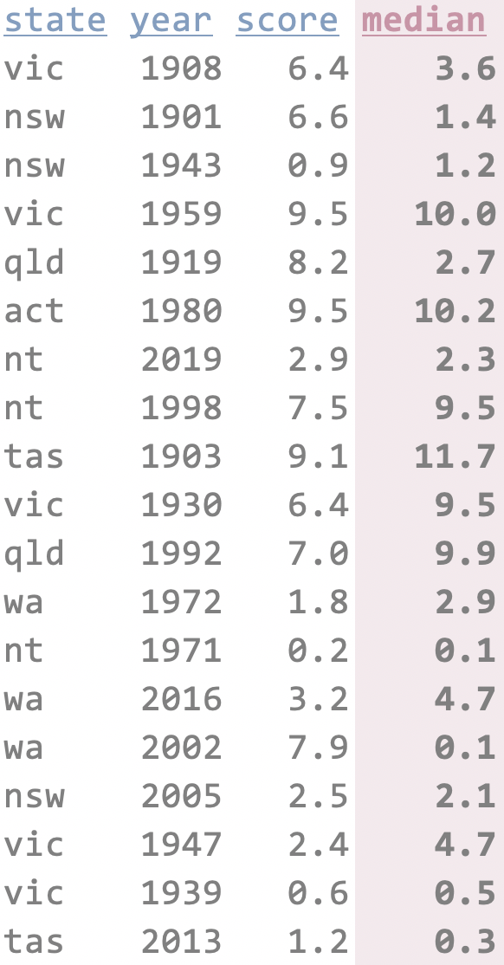
read
add
visualise

Slide 3
preamble
‘Coding’
If you have ever used Excel, you are a coder.
You have used functions to create output. You have written code.
And we can greatly enhance the things we can do by using R.

Slide 4
preamble
A script-based language
R is a script-based program.
You write a list of instructions and R will follow it.
This is wonderfully handy:
everything you have told it to do, it will do;
you have recorded everything you have told it to do.

Slide 5
preamble
Why R
There are many proprietary script-based programs for analysing data: Stata, SAS, Eviews, SPSS, Matlab.
They cost $$$.
If you are not at a university/workplace that has the program, you can’t use it.
Or you will have to pay for a license yourself.

Slide 6
preamble
Why R
Proprietary programs are also centrally controlled.
The select functions are written by the company, and you can only use the set of functions they provide.
R thrives on user-written packages (collections of functions) that are available to everyone, for free. From a recent study:
“In 2015, R added 1,357 packages, counting only CRAN, or approximately 27,642 functions. During 2015 alone, R added more functions than SAS Institute has written in its entire history.” r4stats.com/articles/popularity/ (the potential bias is indicated in its domain)

Slide 7
preamble
Why R
There are other open-source programs available.
Python is a key example. Python is good.
…

Slide 8
preamble
Set up
Install R
Install R Studio
Install packages in R

Slide 9
preamble
Use projects
It helps you tidy your thoughts
It means your code can be shared with anyone
It means you never have to use setwd() again
….

Slide 10
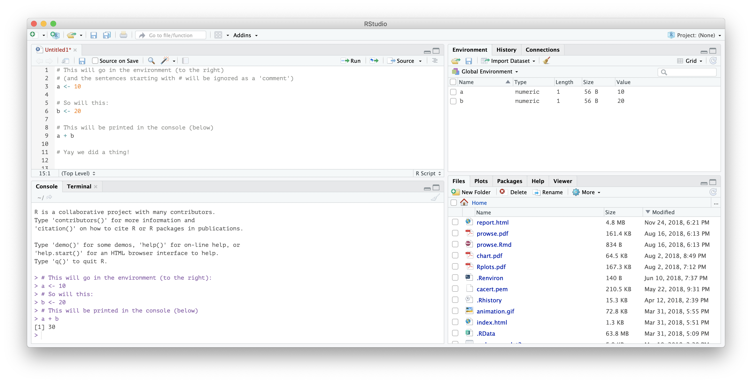
learn
What does R Studio look like?
your
Script
(your list of instructions)
things in your Environment
(the things R knows about)
the
Console
prints the results of your analysis (and presents you with frustrating errors)
The other window for
Files, plots, help
and other things
(a handy window)

Slide 11
learn
Writing a script
Our script will be filled with a list of instructions for R to follow.
Let’s do three things first:
Write a comment starting with # (something R will ignore – it’s just there for you)
Define an object: assign the number 119 to the object named goodnumber
Calculate a thing:
# Hello I am starting my R script
goodnumber <- 119
2 * goodnumber
[1] 238
output is shown in the console

Slide 12
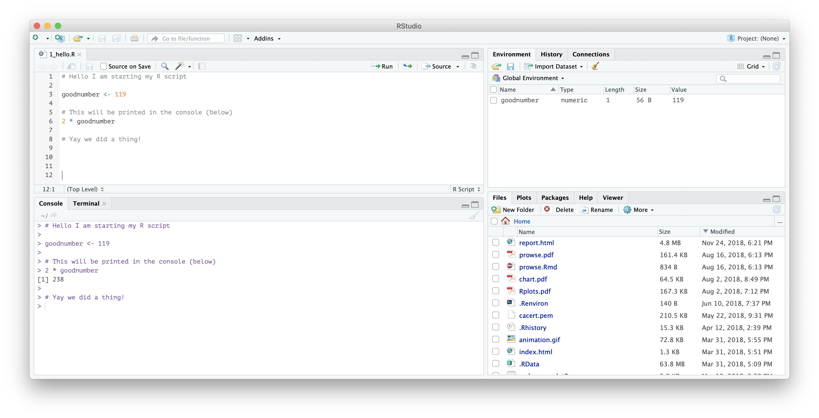
learn
What does that look like?
Our script; our instructions
The object goodnumber is in our environment to use
Output

Slide 13
learn
And now we’re coders.
We have R and R Studio up-and-running.
We have written a comment, defined an object and run a simple analysis.
Now we just have to learn how to do more:
a process you will continue as long as you’re using R.

Slide 14
learn
Functions
A function takes inputs (arguments) and produces outputs.
We can use the c function to combine numbers into a series of numbers (a vector):
c(3, 4, 5)
Combine the numbers 3, 4 and 5 into a single vector
[1] 3 4 5

Slide 15
learn
Functions
We can nest functions:
But nesting is hard to read (especially when it gets complicated)
Alternatively:
mean(c(3, 4, 5))
Combine the numbers 3, 4 and 5 into a vector, then take the mean of that vector.
[1] 4
goodnumbers <- c(3, 4, 5)
mean(goodnumbers)
Combine the numbers 3, 4 and 5 into a vector and assign it to goodnumbers.
Take the mean of goodnumbers.
[1] 4

Slide 16
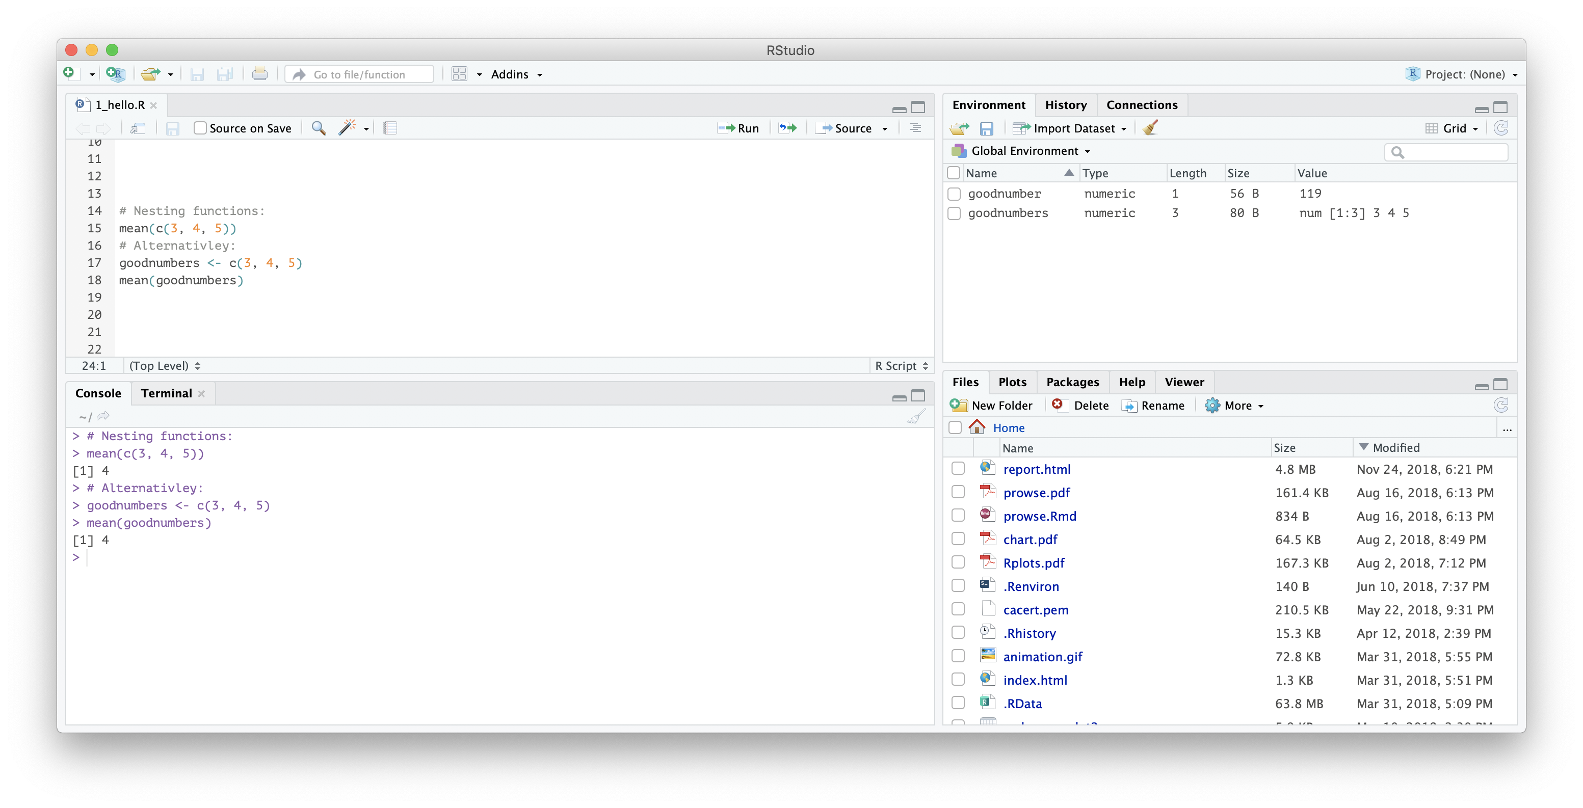
learn
Functions
We run our script and the console will show:
Our script; our instructions
The object goodnumber is in our environment to use
Output in our console

Slide 17
learn
Packages
R uses functions to do things. A package is a collection of functions.
Some packages are installed when you install R. this is called “base R”
Other user-written packages can be installed using:
install.packages(“nameofpackage”)

Slide 18
learn
The tidyverse is a package
(Well, the tidyverse is a collection of packages)
They are intuitive and consistent.
They help you read, manipulate and visualise your data with less hassle.
It’s best to see how these functions are used.

Slide 19
read
code line
16
Let’s get into it.
From R Studio, open: 2_thescript.R.
The script is long! It does lots of things.
But we’re going to take it one step at a time.
Note: to run the code where our cursor is, or what you have highlighted, use the keyboard shortcut
CTRL + ENTER or CMD + RETURN
34

Slide 20
learn
Data frames
A data frame is data in two-dimensional space
(rows and columns; think of an Excel sheet)
gapminder <- read_csv(“data/gapminder.csv”)
Change to gapminder

Slide 21
learn
Look at the gapminder dataset and picture it in your mind.
Now close your eyes and:
Create a new column gdp that is the product of gdpPercap and pop.
Filter the observations to exclude those from 2007.
Remove the gdpPercap column.
What does this dataset look like now?

Slide 22
learn
Doing that in code:
Create a new column gdp that is the product of gdpPercap and pop.
Create or change columns using mutate.
Redefine the object gapminder
gapminder <- gapminder %>%
mutate(gdp = gdpPercap * pop)
to be the gapminder dataset and
mutated to have an additional column called gdp which is the product of gdpPercap and pop.

Slide 23
learn
Doing that in code:
Filter the observations to exclude those from 2007.
Filter observations using filter.
== means is equal to
!= means is not equal to
Redefine the object gapminder
gapminder <- gapminder %>%
filter(year != 2007)
to be the gapminder dataset and
filtered to all observations where year does not equal 2007.

Slide 24
learn
Doing that in code:
Remove the gdpPercap column.
Drop columns using select.
Redefine the object gapminder
gapminder <- gapminder %>%
select(-gdpPercap)
to be the gapminder dataset and
Negatively select (drop) the variable gdpPercap

Slide 25
learn
Combining it all:
gapminder <- gapminder %>%
mutate(gdp = gdpPercap * pop) %>%
filter(year != 2007) %>%
select(-gdpPercap)
Take the gapminder dataset and
Add a column called gdp which is the product of gdpPercap and pop and
Filter observations where year does not equal 2007 and
Negatively select (drop) the variable gdpPercap.
Now the gapminder dataset is what you pictured!

Slide 26
Show that the data looks like

Slide 27
visualise
code line
Explore
How can we properly see our data?
We need:
Data (the data to be mapped)
Aesthetics (variables in the data to be mapped)
Geoms (how to map the things)
81
161

Slide 28
visualise
code line
Explore
We can use ggplot’s framework to make a visualisation.
Take data
Start ggplot and tell it what you want to map
Map those things with a geom
gapminder %>%
81
ggplot(aes(x = lifeExp,
y = gdp)) +
161
geom_point()

Slide 29
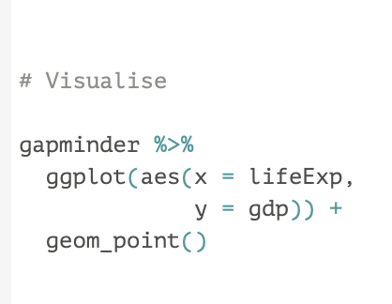

Slide 30
visualise
code line
Explore
Really look at the data
What are you working with?
What seems off?
81
161

Slide 31
learn
We want to rename the variable score to school_score.
We can do this with the tidyverse function rename:
state_scores <-
rename(state_scores,
school_score = score)
pws: take the dataset state_scores and rename the variable score as school_score. Assign (<-) this new dataset to be the new state_scores dataset.

Slide 32
Want the data to be:
Tidy
Time-series
Scatter-able
Mappable
Gapminder?
ABS state-based time-series

Slide 33
learn
The tidyverse is a package
The tidyverse is a collection of packages that are intuitive and consistent.
state_scores <-
plain-word syntax [pws]: the left-hand side (state_scores) is defined as (assigned) the dataset.

Slide 34
preamble
There are different ways to do the same thing! If we wanted to avoid tidyverse and instead use base R, we could:
names(state_scores)[3] <- “state_schools”
ie: take the third element of the names character-vector for the dataset state_scores and replace it with “state_schools”.
But: it’s hard to read and hard to interpret.
And it’s easy to mess up (what if the name we wanted to replace wasn’t the third, but the fourth?)

Slide 35
preamble is almost over
‘Piping’ data
….

Slide 36
preamble is over!
We have installed R and R Studio.
We have installed packages.
We assign things with <-.
We can ‘pipe’ things with %>%.
Now we can move onto interesting things.

Slide 37
read
code line
16
34
Get your data into R
Can be the biggest hassle
Also the least fun.
Annoying that it’s at the start.
But it is.
(Sorry)
There are very handy packages to help

Slide 38
read
code line
35
We will use the tidyverse set of packages to read, add to and explore our data.
To read a .csv (comma separated values) file into R:
44
our_data <- read_csv(“data/vet_data.csv”)

Slide 39
manipulate
code line
Add and analyse
45
76

Slide 40
explore
code line
Really look at the data
What are you working with?
What seems off?
81
161

Slide 41
explore
code line
Explore numerically
functions to do this
81
161

Slide 42
explore
code line
Explore visually
ggplot
81
161

Slide 43
explore
code line
Explore visually
ggplot
81
161

Slide 44
analyse
code line
What do we want to do with the data?
129
134

Slide 45
explore
that doesn’t look right
that’ll fix it
add
ooh this is interesting maybe we should…
analyse

Slide 46
communicate
code line
You now have a message:
Communicate it to your audience and convince them they should care.
135
154

Slide 47
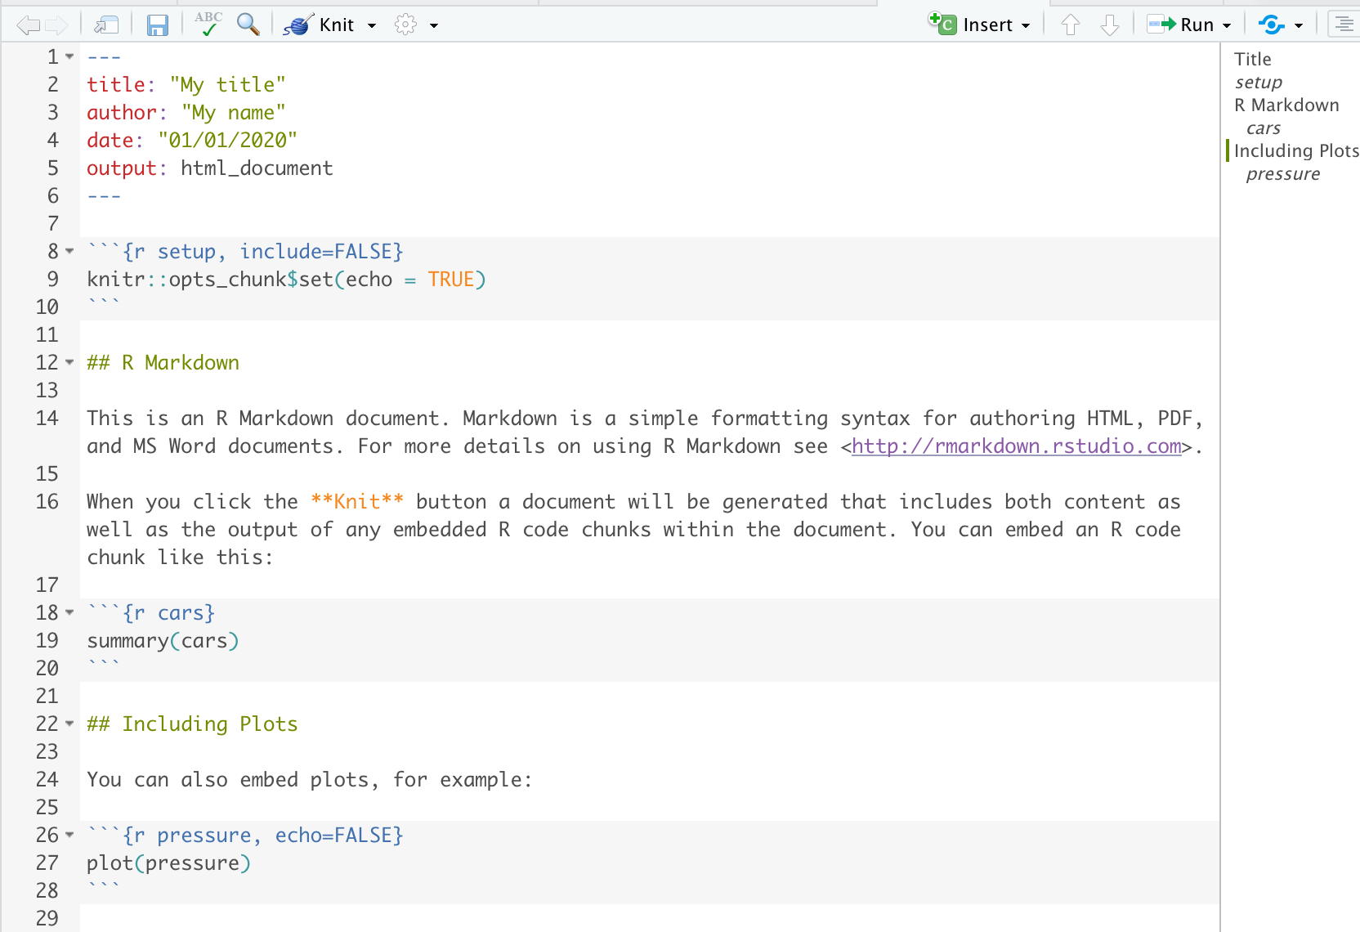
YAML: instructions for your R Markdown output
A level-2 header
Your text. Just write as your normally would.
A ‘chunk’ of R code
Another ‘chunk’ of R code

Slide 48
explore and understand
visualise
read
communicate
transform
analyse

Slide 49
Our gapminder dataset:
country | continent | year | lifeExp | pop | gdpPercap
… | … | … | … | … | …
Australia | Oceania | 1952 | 69.1 | 8,691,212 | 10,040
Australia | Oceania | 1957 | 70.3 | 9,712,569 | 10,950
Australia | Oceania | 1962 | 70.9 | 10,794,968 | 12,217
Australia | Oceania | 1967 | 71.1 | 11,872,264 | 14,526
Australia | Oceania | 1972 | 71.9 | 13,177,000 | 16,789
Australia | Oceania | 1977 | 73.5 | 14,074,100 | 18,334
Australia | Oceania | 1982 | 74.7 | 15,184,200 | 19,477
Australia | Oceania | 1987 | 76.3 | 16,257,249 | 21,889
Australia | Oceania | 1992 | 77.6 | 17,481,977 | 23,425
Australia | Oceania | 1997 | 78.8 | 18,565,243 | 26,998
Australia | Oceania | 2002 | 80.4 | 19,546,792 | 30,688
Australia | Oceania | 2007 | 81.2 | 20,434,176 | 34,435
… | … | … | … | … | …

Slide 50
Add a column with mutate()
country | continent | year | lifeExp | pop | gdpPercap
… | … | … | … | … | …
Australia | Oceania | 1952 | 69.1 | 8,691,212 | 10,040
Australia | Oceania | 1957 | 70.3 | 9,712,569 | 10,950
Australia | Oceania | 1962 | 70.9 | 10,794,968 | 12,217
Australia | Oceania | 1967 | 71.1 | 11,872,264 | 14,526
Australia | Oceania | 1972 | 71.9 | 13,177,000 | 16,789
Australia | Oceania | 1977 | 73.5 | 14,074,100 | 18,334
Australia | Oceania | 1982 | 74.7 | 15,184,200 | 19,477
Australia | Oceania | 1987 | 76.3 | 16,257,249 | 21,889
Australia | Oceania | 1992 | 77.6 | 17,481,977 | 23,425
Australia | Oceania | 1997 | 78.8 | 18,565,243 | 26,998
Australia | Oceania | 2002 | 80.4 | 19,546,792 | 30,688
Australia | Oceania | 2007 | 81.2 | 20,434,176 | 34,435
… | … | … | … | … | …
gdp
…
87,259,768,480
106,352,630,550
131,882,124,056
172,456,506,864
221,228,653,000
258,034,549,400
295,742,663,400
355,854,923,361
409,515,311,225
501,224,430,514
599,851,952,896
703,650,850,560
…

Slide 51
Filter with filter()
country | continent | year | lifeExp | pop | gdpPercap
… | … | … | … | … | …
Australia | Oceania | 1952 | 69.1 | 8,691,212 | 10,040
Australia | Oceania | 1957 | 70.3 | 9,712,569 | 10,950
Australia | Oceania | 1962 | 70.9 | 10,794,968 | 12,217
Australia | Oceania | 1967 | 71.1 | 11,872,264 | 14,526
Australia | Oceania | 1972 | 71.9 | 13,177,000 | 16,789
Australia | Oceania | 1977 | 73.5 | 14,074,100 | 18,334
Australia | Oceania | 1982 | 74.7 | 15,184,200 | 19,477
Australia | Oceania | 1987 | 76.3 | 16,257,249 | 21,889
Australia | Oceania | 1992 | 77.6 | 17,481,977 | 23,425
Australia | Oceania | 1997 | 78.8 | 18,565,243 | 26,998
Australia | Oceania | 2002 | 80.4 | 19,546,792 | 30,688
Australia | Oceania | 2007 | 81.2 | 20,434,176 | 34,435
… | … | … | … | … | …
gdp
…
87,259,768,480
106,352,630,550
131,882,124,056
172,456,506,864
221,228,653,000
258,034,549,400
295,742,663,400
355,854,923,361
409,515,311,225
501,224,430,514
599,851,952,896
703,650,850,560
…
Dropped
Kept

Slide 52
Drop a variable with select()
country | continent | year | lifeExp | pop | gdpPercap
… | … | … | … | … | …
Australia | Oceania | 1952 | 69.1 | 8,691,212 | 10,040
Australia | Oceania | 1957 | 70.3 | 9,712,569 | 10,950
Australia | Oceania | 1962 | 70.9 | 10,794,968 | 12,217
Australia | Oceania | 1967 | 71.1 | 11,872,264 | 14,526
Australia | Oceania | 1972 | 71.9 | 13,177,000 | 16,789
Australia | Oceania | 1977 | 73.5 | 14,074,100 | 18,334
Australia | Oceania | 1982 | 74.7 | 15,184,200 | 19,477
Australia | Oceania | 1987 | 76.3 | 16,257,249 | 21,889
Australia | Oceania | 1992 | 77.6 | 17,481,977 | 23,425
Australia | Oceania | 1997 | 78.8 | 18,565,243 | 26,998
Australia | Oceania | 2002 | 80.4 | 19,546,792 | 30,688
Australia | Oceania | 2007 | 81.2 | 20,434,176 | 34,435
… | … | … | … | … | …
gdp
…
87,259,768,480
106,352,630,550
131,882,124,056
172,456,506,864
221,228,653,000
258,034,549,400
295,742,663,400
355,854,923,361
409,515,311,225
501,224,430,514
599,851,952,896
703,650,850,560
…
Dropped

